Slide 1
Proposal for Techopoly Inc.
By Simple Services Inc.

Slide 2
Summary
Provides a simple solution to the building’s network setup
Cost efficient
Simple Permissions setup for networked workstations

Slide 3
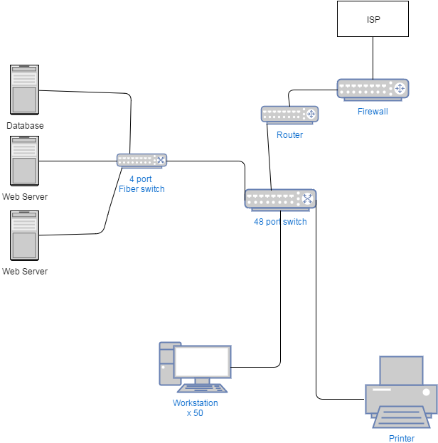
Network Diagram

Slide 4
Cost Summary
ITEM | Model # | Quanity | Price | Total cost
TP-LINK TL-SG1048 48-Port 10/100/1000Mbps Gigabit 19-inch Rackmount Switch |  | 1 | $322.99 | $322.99
Fast Ethernet switch 4+1 fiber ports, unmanaged, SC 2Km multi-mode fiber port |  | 1 | $81.00 | $81.00
Tripp Lite 3M 10Gb Duplex Multimode 50/125 OM3 Fiber Cable LC/LC Aqua 10ft |  | 3 | $20.99 | $62.97
100Mbps Full/Low Profile Ethernet Multi Mode SC Fiber PCI NIC Card 2km |  | 3 | $129.99 | $389.97
CAT 6 - UTP 1000 ft – Blue |  | 2 | $107.00 | $214.00
Platinum Tools 100010C EZ-RJ45 Cat 6+ Connectors, Clamshell, 50-Pieces |  | 2 | $31.59 | $63.18
Netgear FVS318G ProSafe 8 Port Gigabit VPN Firewall | FVS318G-100NAS | 1 | $136.88 | $136.88
HP Compaq Z600 Workstation PC - Intel Xeon Quad-Core 2.4GHz, 8GB DDR3, 1TB HDD, DVDRW, 65W PSU, Windows 7 Professional 64-bit, Keyboard & Mouse |  | 50 | $399.99 | $19,999.50
Acer G226HQL Bbd 21.5-inch Full HD (1920 x 1080) Widescreen Display |  | 50 | $89.99 | $4,499.50
HP P4515x Monochrome LaserJet Printer |  | 5 | $350.00 | $1,750.00
Dell Poweredge R720xd Server 1 x 6C E5-2640 32GB 3x1TB SAS 2x500GB SATA |  | 3 | $4,299.00 | $12,897.00
APC Smart-UPS SMT3000RM2U 3000VA Rack-mountable UPS |  | 1 | $1,327.99 | $1,327.99
Cable Termination and Installation Alotment |  |  | $5,000.00 | $5,000.00
Rosewill RPS-100 6-Outlet Power Strip, 125 V Input, 1875 Maximum Power Output, 3 Feet Cord |  | 35 | $4.99 | $174.65
Total cost |  |  |  | $46,919.63

Slide 5
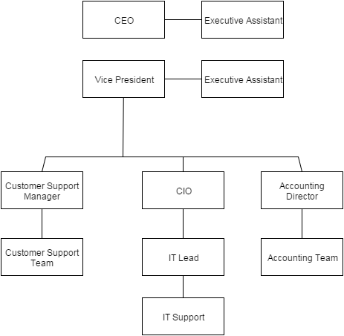
Microsoft Active Directory tree structure

